Slide 1
Navitrol navigation system

Slide 2
Navitrol options
Positioning only
Positioning with route following capability
Software only or hardware + software
Mission and traffic control system for a fleet of AGVs is also available

Slide 3
Positioning
Positioning uses natural features and map matching algorithms to determine the x,y and heading
Reflectors can be used to improve positioning if the environment does not provide enough natural features
Position accuracy is ±1cm, heading accuracy 1 degree and maximum speed can be 3m/s.
Position can be updated up to 30 Hz rate

Slide 4
Other features
Navitrol reports position confidence
Navitrol reports any operational errors
Environment can be divided into floors
Remote monitor tool for showing diagnostic data in real time

Slide 5
Dead reckoning integration
Navitrol provides the real position by combining dead reckoning position with map based position
Options to get dead reckoning data:
AGV controller sends dead reckoning pose to Navitrol over Ethernet and Navitrol replies with the corrected pose
AGV controller sends the distance traveled and the steering angle over Ethernet and Navitrol replies with the corrected pose
Navitrol reads the raw data directly from sensors

Slide 6
Position initialization
Position must be initialized
Initial position must be given with 1m position accuracy and 10 degrees of heading accuracy
After the initial position is given Navitrol maintains the accurate position

Slide 7
Environment teaching
Navitrol is set into teaching mode
Navitrol records the dead reckoning position and scanner measurements
The AGV is driven manually through the operation area
Teaching is stopped
Data is saved to a laser data file.

Slide 8
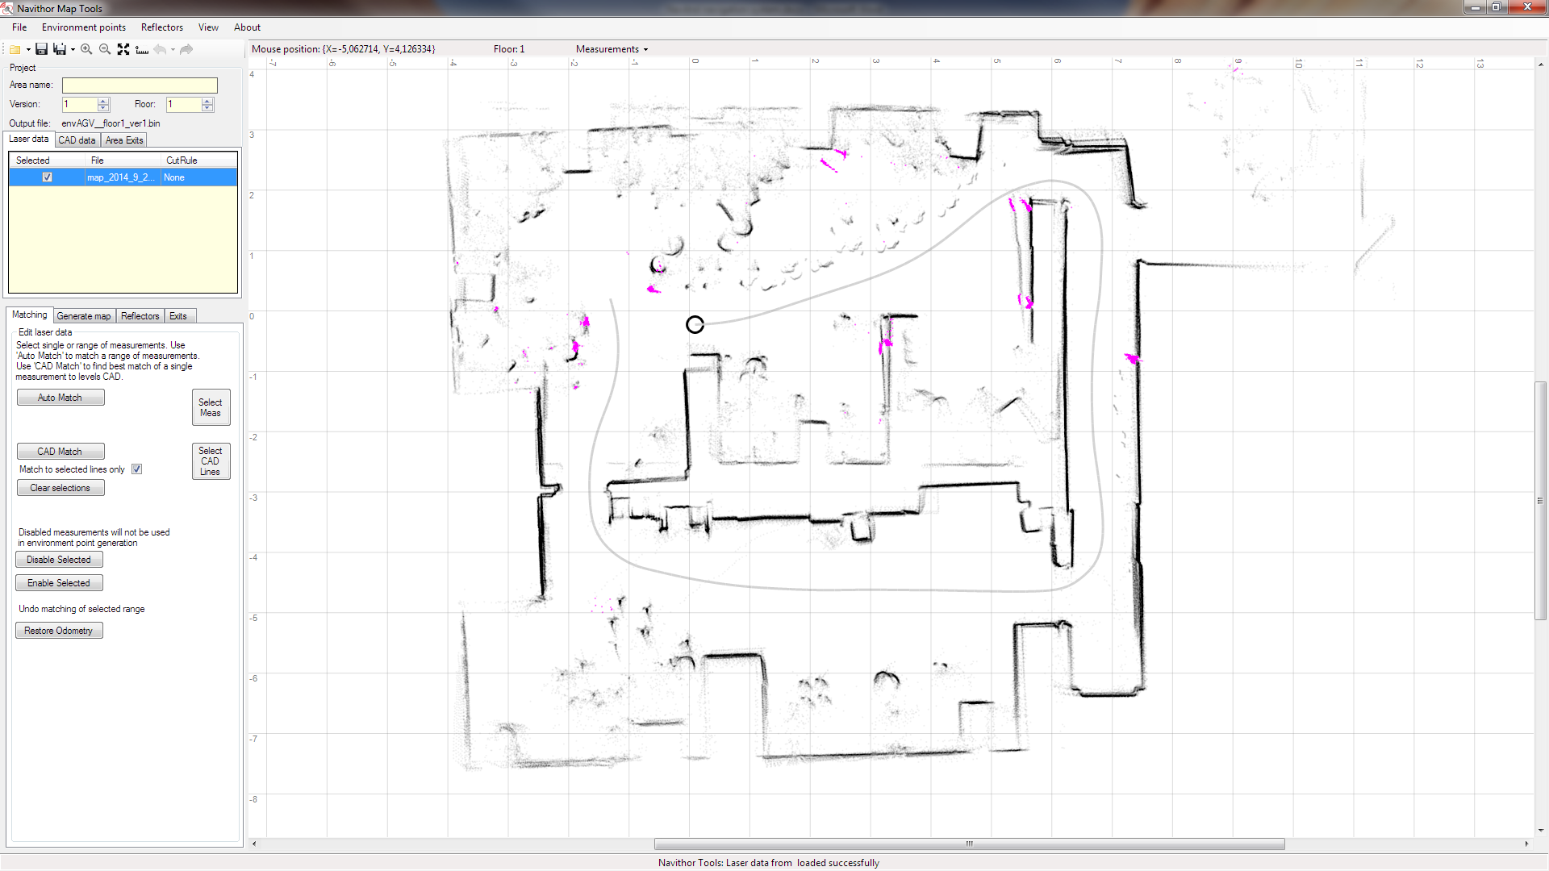
Map editing (start)
Navithor map tool shows the raw laser and dead reckoning data
Also CAD data can be shown on the map.

Slide 9
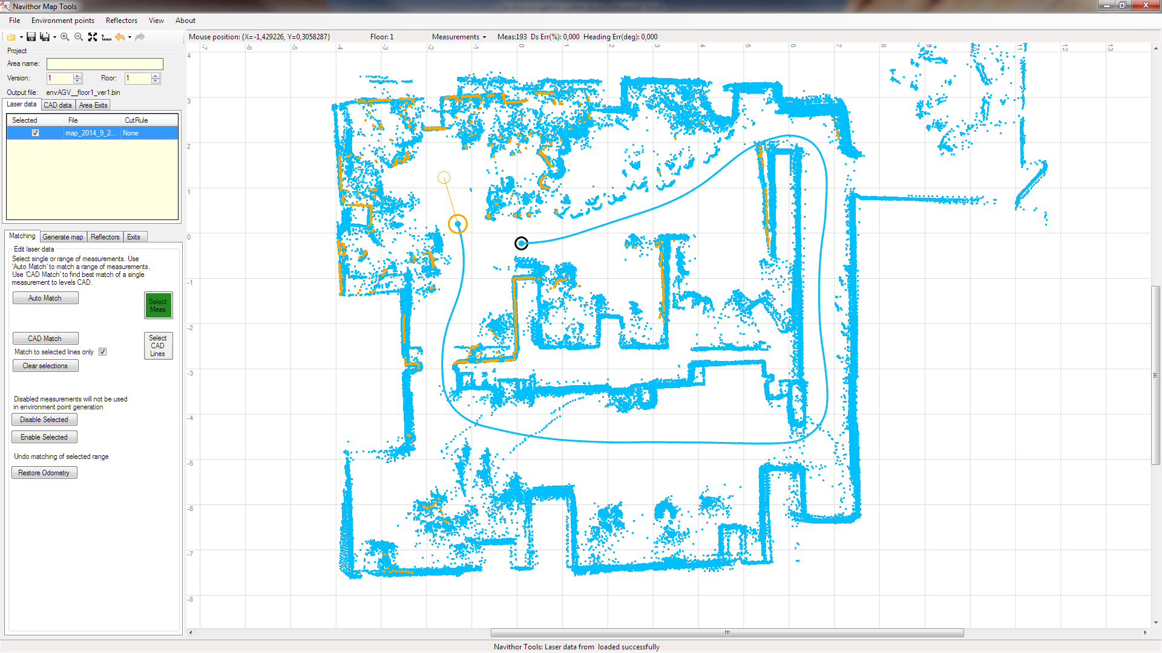
Map editing (selecting measurements)
User can select any number of measurements for editing

Slide 10
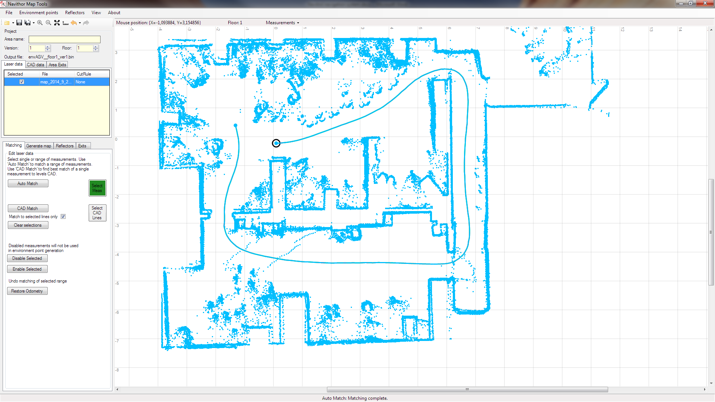
Map editing (auto match)
Auto match tool matches the measurements
to each other correcting dead reckoning errors

Slide 11
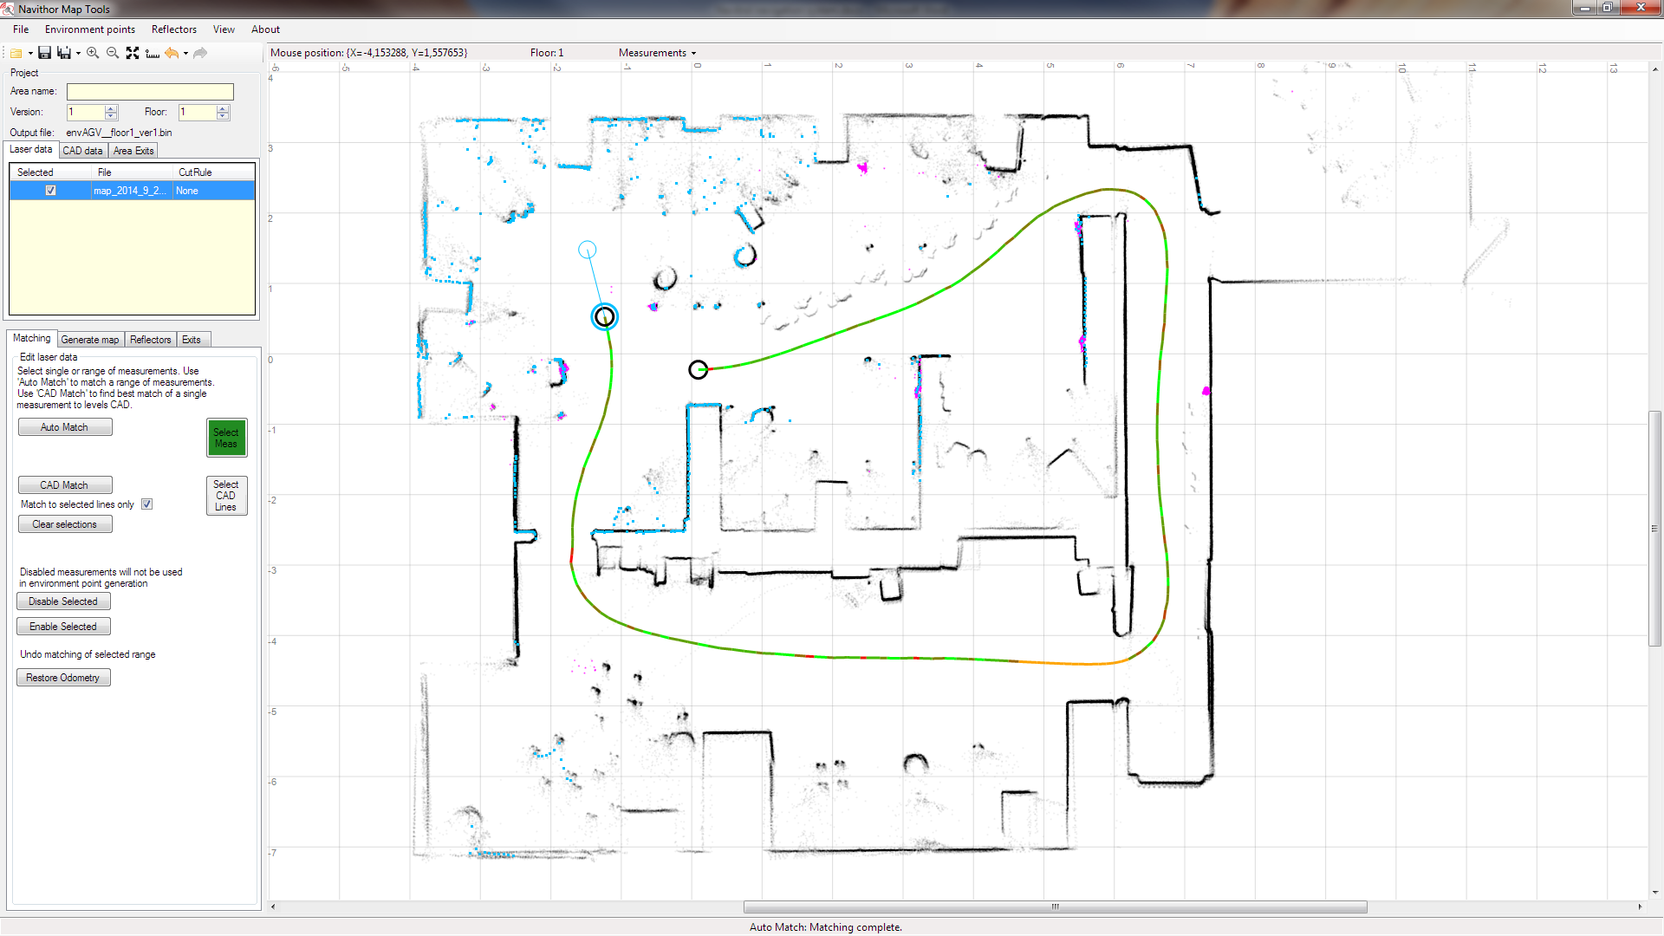
Map editing (manual editing)
Manual editing allows to do the last fine tuning

Slide 12
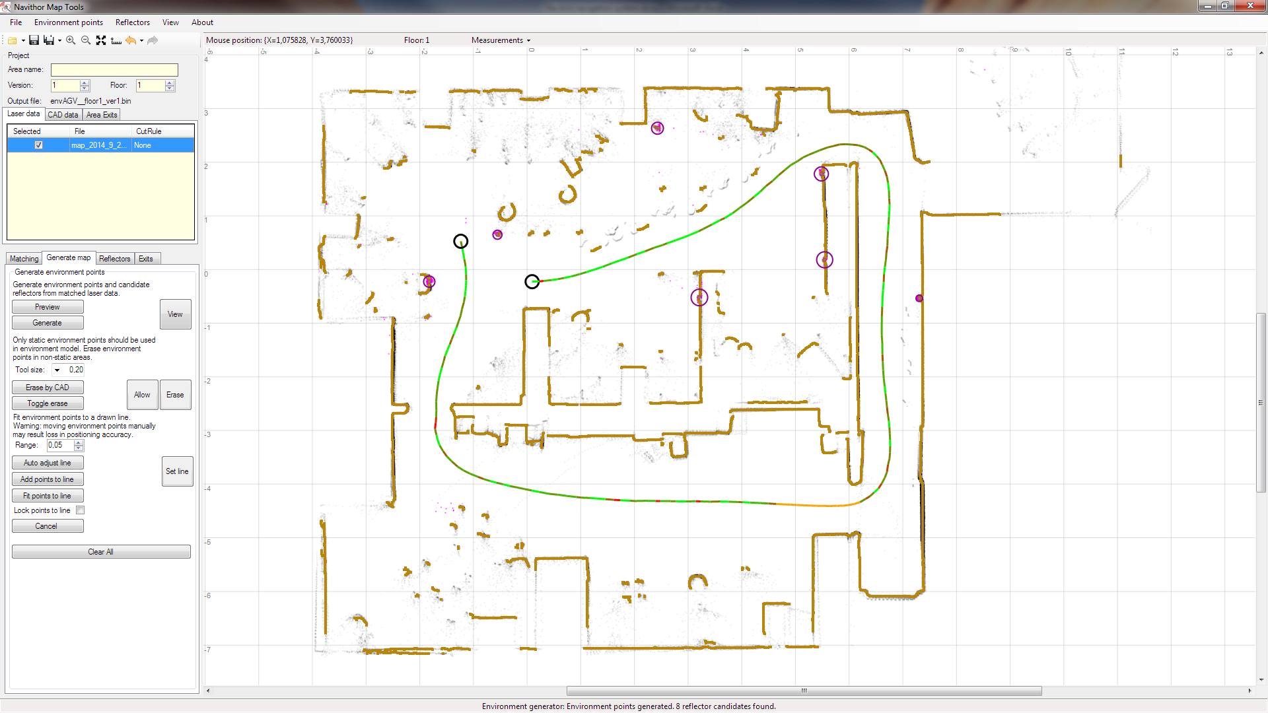
Map editing (generating map)
Map is generated from the corrected measurements

Slide 13
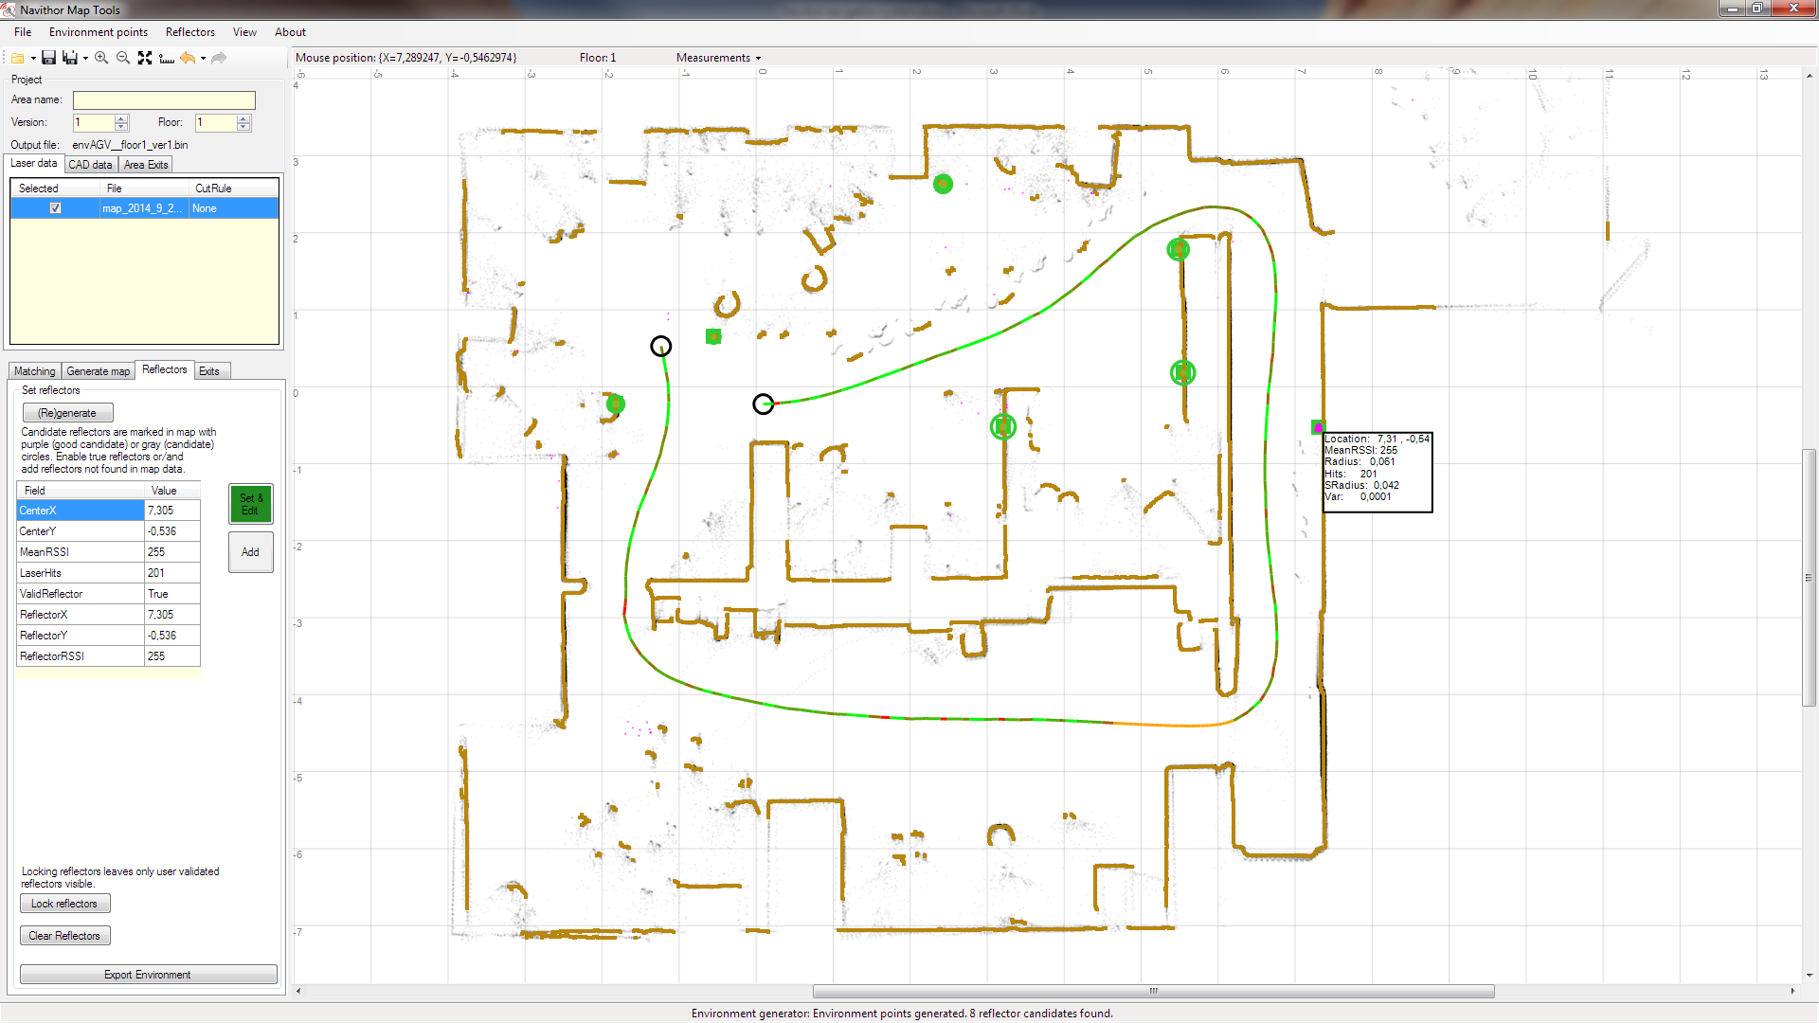
Map editing (reflectors)
Reflectors (green) are selected from the map

Slide 14
Exporting map
When the map is ready it is saved into a file
All the editing steps in the example were done in less than 2 minutes
The map file is moved to Navitrol
Navitrol is restarted and the new map is used for positioning

Slide 15
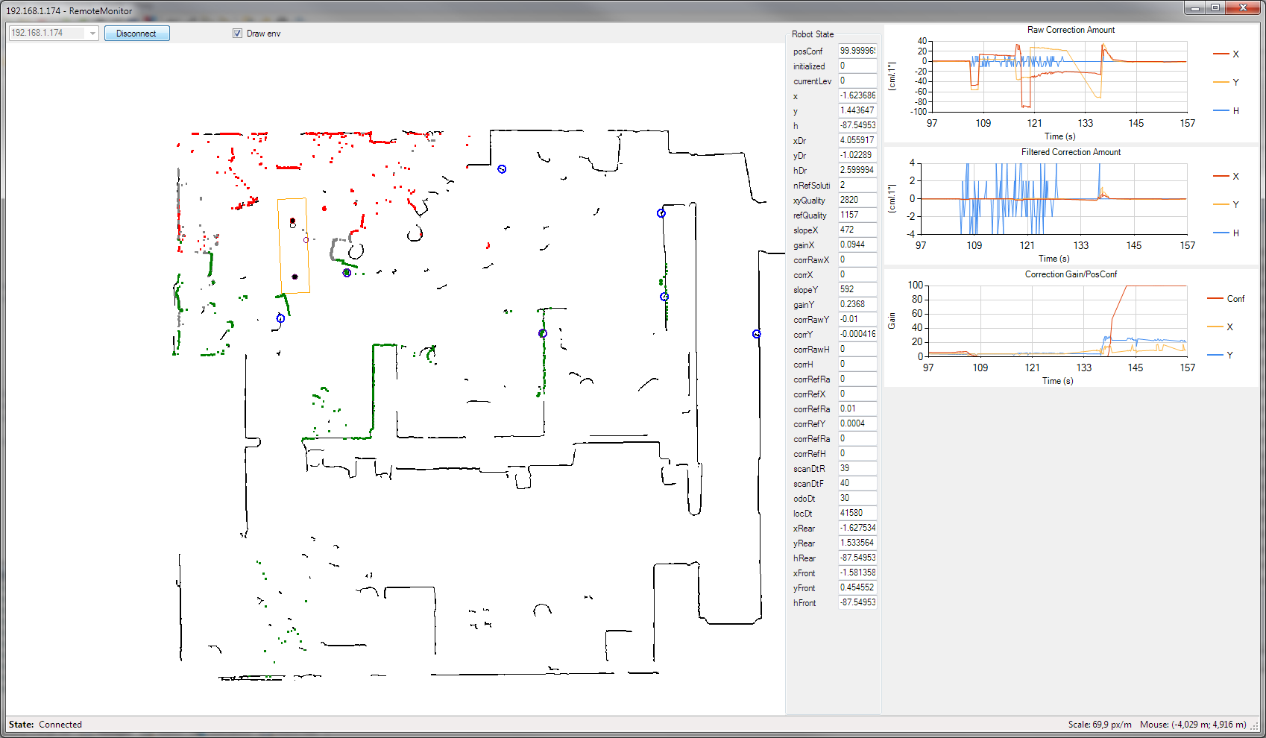
Remote monitor
Remote monitor shows the live laser data and measurements from Navitrol

